Slide 1
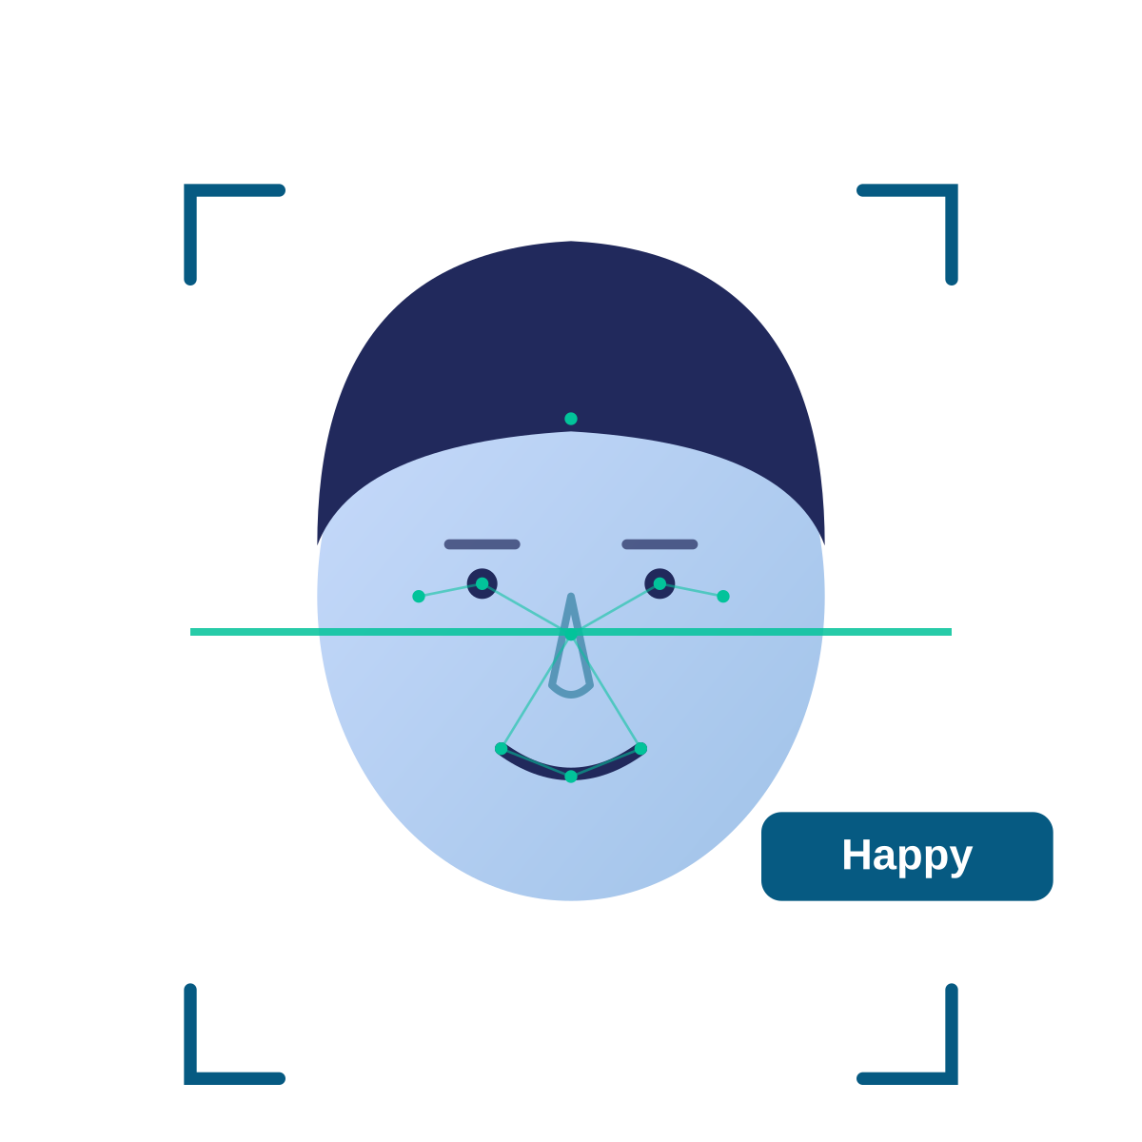
FACIAL EMOTION
DETECTION
Presented by: Mahi Jha and Vanshika Kandpal
MCA — NIT Warangal
Python Lab Project

Slide 2


Project Overview
Detects a human face from an image or webcam input.
Face Image
AI Model
The detected face is processed and given to a trained CNN model.
→
→
"Happy"
The model classifies the visible facial expression into one of seven predefined categories.
The prediction is displayed through a simple Streamlit interface.
Dataset: FER-2013
7 Expression Classes
Problem Being Solved
Angry
Disgust
Fear
Manual interpretation of facial expressions can be subjective and difficult when many faces need to be analyzed. This project demonstrates an automated approach to facial-expression classification.
Happy
Sad
Surprise
Neutral
2

Slide 3






Technology Stack & Project Flow
Technology Stack
Overall Project Flow
Python
PHASE 1 — TRAINING
PHASE 2 — PREDICTION
Core programming language
FER-2013 Dataset
Image / Webcam
OpenCV
▾
▾
Face detection & image processing
Image Preprocessing
OpenCV Face Detection
TensorFlow / Keras
▾
▾
CNN model development & training
CNN Training
Preprocessing
(Grayscale → Resize 48×48 → Normalize)
NumPy
▾
▾
Numerical & image-array processing
Trained CNN Model
Emotion Prediction
Streamlit
▾
User interface
Streamlit Display
FER-2013
Training / testing dataset
3

Slide 4

How the System Works
1
Image / Webcam Input
6
Normalize Image
Example
Detect Face
CNN Model
Input Face
2
7
▾
3
Extract Face
8
Predict Facial Expression
Image Processing
4
Convert to Grayscale
9
Display Result
▾
CNN Prediction
5
Resize to 48 × 48
"Happy" — predicted expression
The input face is converted into a consistent format before being passed to the trained model. The model then predicts the most likely facial-expression category.
4

Slide 5
Limitations & Future Scope
Limitations
Future Scope
Poor lighting can affect face detection and prediction.
Side-facing or partially hidden faces may reduce performance.
Improve the CNN model and training process.
Masks, glasses, or hands can hide important facial features.
Support multiple faces in a single frame.
Similar facial expressions can be difficult to distinguish.
Improve real-time webcam performance.
Performance depends on the quality and diversity of the dataset.
Deploy the application as a web-based system.
Facial expression does not always represent a person's actual emotion.
Evaluate the model using accuracy and confusion matrix.
Goal: Build a lightweight and accessible facial-expression classification system.
5

